Slide 1
Smart Home Automation System - DDoS Detection for IoT Networks
Jay Patel
DEEP RAKSHESHKUMAR PATEL
DEEPKUMAR V PATEL

Slide 2
Introduction
Smart home automation systems are becoming increasingly popular, with various Internet of Things (IoT) devices, such as cameras, thermostats, and smart appliances, being interconnected within homes for enhanced convenience and efficiency.
The increasing prevalence of IoT devices, including cameras with an internet capability, has raised concerns about their vulnerability to Distributed Denial of Service (DDoS) attacks.
DDoS attacks can cause serious disruptions to IoT networks, affecting their functionality and performance. Machine learning can be used to develop effective DDoS detection systems for IoT networks

Slide 3
Approach
Conduct a comprehensive review of existing machine learning techniques for network traffic analysis and anomaly detection, such as supervised and unsupervised learning algorithms, clustering techniques, and deep learning models.
Collect and preprocess relevant data from simulated or real-world smart home automation systems, including network traffic data, device behavior data, and other relevant features.
Based on the chosen machine learning techniques, develop algorithms or models for real-time traffic analysis, feature extraction, and decision-making for DDoS detection and implement a dynamic firewall system that incorporates the developed ML algorithm.
Evaluate the performance of the dynamic firewall system using appropriate metrics, such as detection accuracy, false positive rate, and processing efficiency. Prepare a comprehensive report documenting the approach taken, the implementation of the dynamic firewall system, the experimental results, and the findings of the research project.

Slide 4
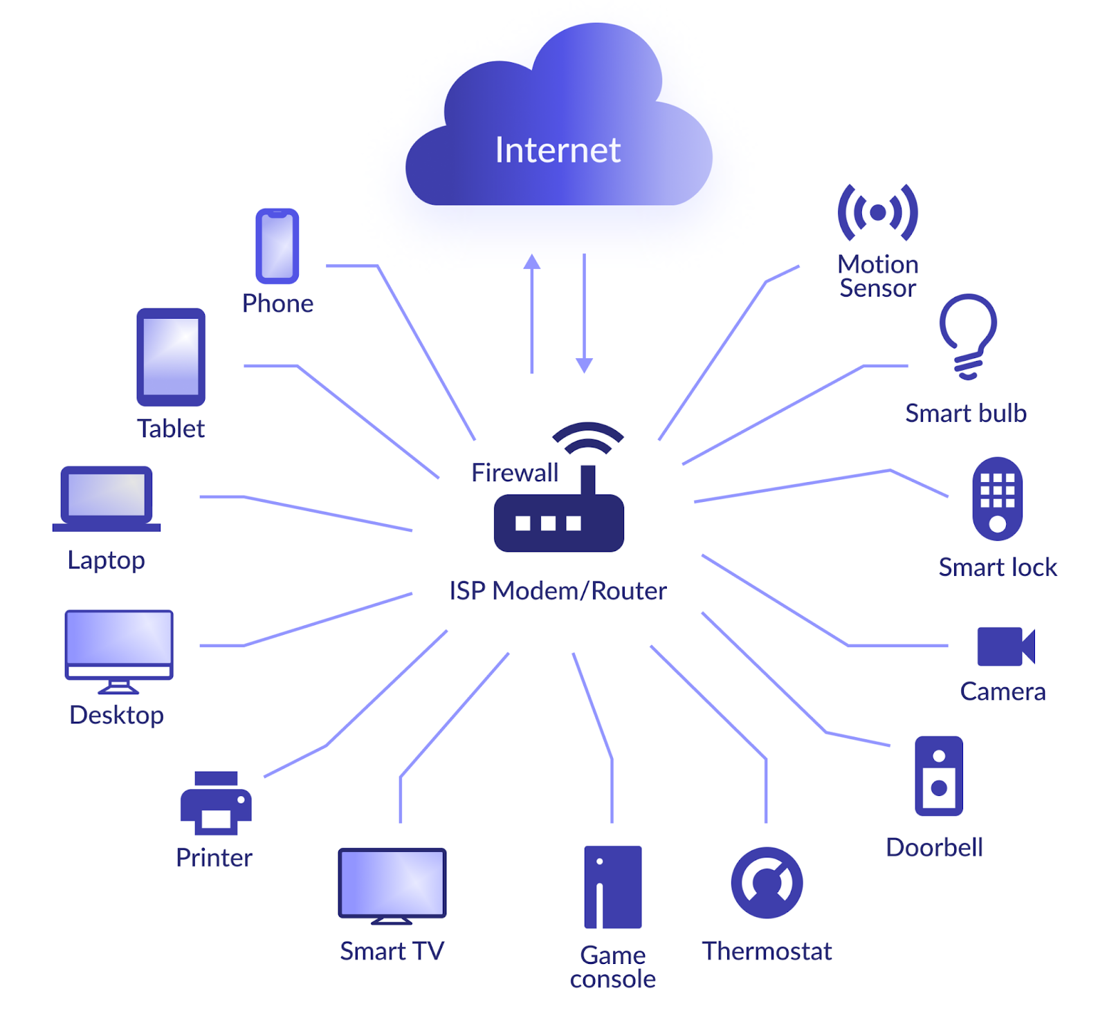
Architectural Diagram

Slide 5
Proposed new idea and research plan
Define the scope and objectives of the project
Review existing literature and research
Choose appropriate machine-learning techniques
Test and evaluate the prototype
Document and communicate results

Slide 6
Steps we took
Locate a high-quality dataset and perform a thorough comparative analysis to determine its suitability for the project.
Conduct a detailed analysis of the dataset, including cleaning and pre-processing of the data to ensure its quality and reliability.
Visualize the data using graphs and other appropriate tools to gain insights into the data and identify patterns or anomalies.
Select an appropriate machine learning algorithm that best fits the project's needs and objectives.

Slide 7
Steps we took
Train the machine learning model using the pre-processed data to learn from patterns and relationships within the dataset.
Evaluate the machine learning model's performance using appropriate metrics to assess its accuracy and effectiveness.
Compare the performance of the machine learning model with existing detection tools to determine its advantages and limitations.

Slide 8
Dataset
DDOS Attack Dataset Selected Features
Selected Features | Description
pkSeqID | Row Identifier
saddr | Source IP address
daddr | Destination IP address
pkts | Total count of packets in transaction
bytes | Total number of bytes in transaction
attack | 0: Normal traffic, 1: DDoS attack
category | Traffic category

Slide 9
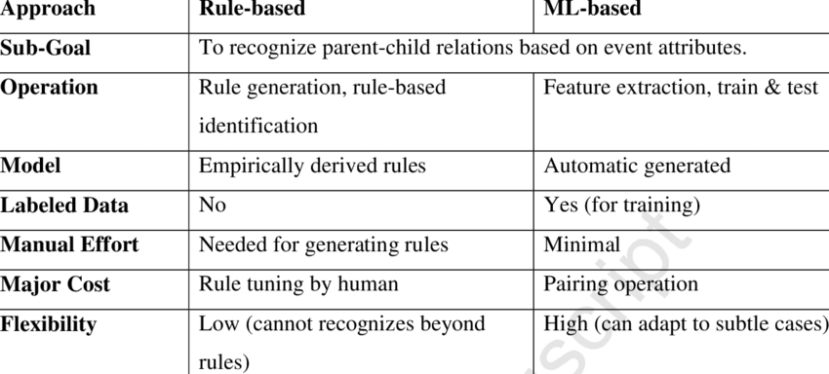
Rule-based approaches
Typically relies on predefined rules or signatures to detect DDoS attacks based on known patterns or characteristics.
Limitations: may not be effective in detecting new or unknown types of DDoS attacks that do not match the predefined rules

Slide 10
Rule-based approaches
DDOS attack detects on specific source IP address if there are more number of packets send to the destination address
for key,value in my_dict.items(): # get a list of dictionary items for i in range(len(value) -1): # iterate over the list of items diff = value[i+1] - value[i] if diff >= 6: print('DDOS attack on IP Address: ', key, "with a packet difference of ", diff) ips.append(key) packets.append(diff)

Slide 11
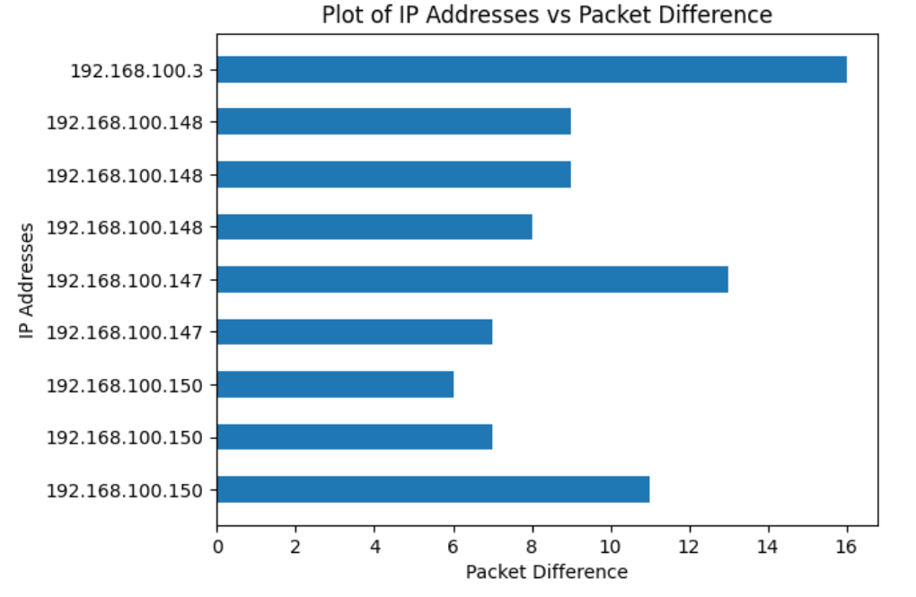
Rule-based approaches

Slide 12
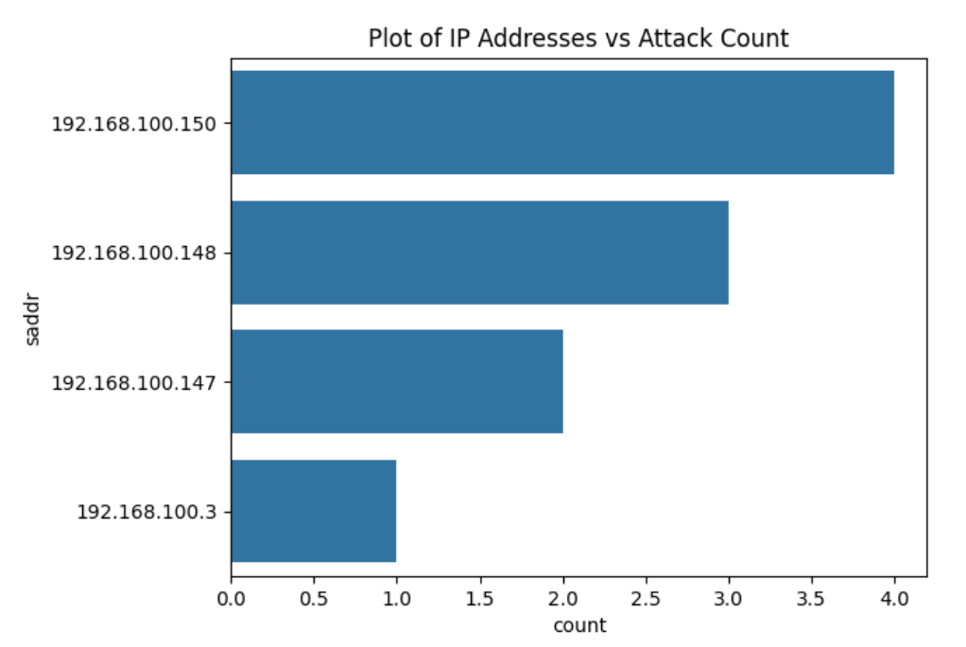
Rule-based approaches

Slide 13
Machine Learning based approach
Analysis of network traffic patterns to detect anomalies that may indicate DDoS attacks.
Provides various features of the network traffic, such as Source IP address, Destination IP address, number of packets, packet frequency, and attack records are analyzed and used to build a model of normal traffic behavior
Limitations: require more computational resources therefore not suitable for resource-constrained IoT devices

Slide 14
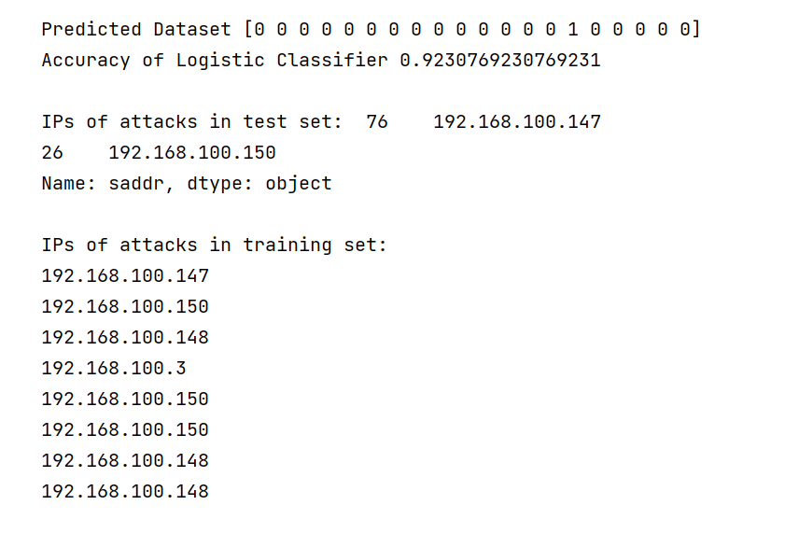
Machine Learning Algorithms
Logistic Regression: Map the predicted values to the range of 0 to 1, which can be interpreted as the probability of a particular outcome and allows it to model nonlinear relationships between the predictor variables and the outcome

Slide 15
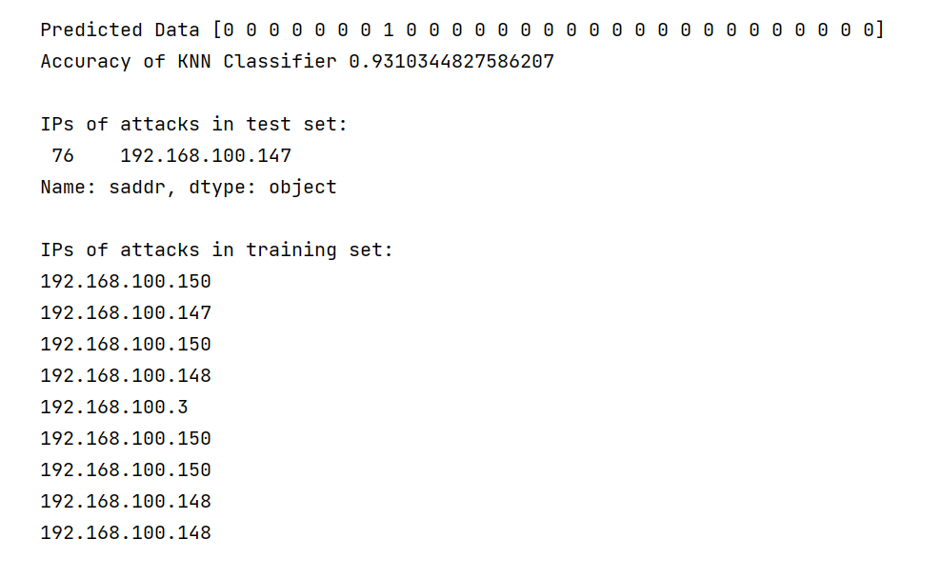
Machine Learning Algorithms
K-nearest neighbor (KNN): It doesn't make any assumptions about the underlying distribution of the data and instead uses the entire training dataset to make predictions

Slide 16
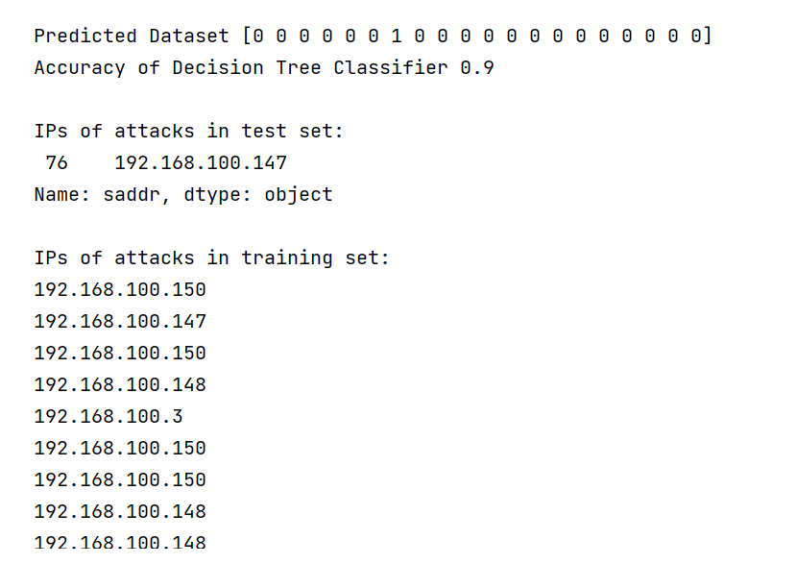
Machine Learning Algorithms
Decision Tree: Tree-like model where each node represents a feature or attribute, each branch represents a decision rule based on the value of that attribute, and each leaf node represents a class label

Slide 17
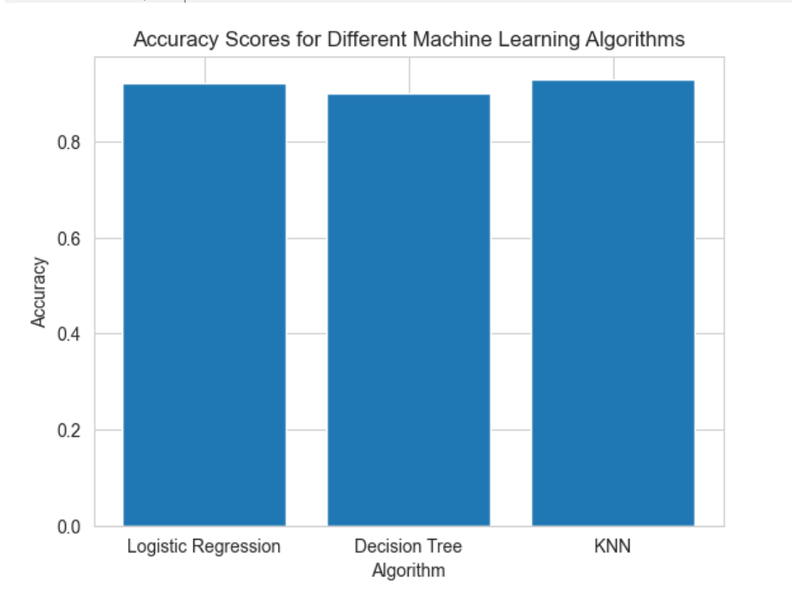
Model Comparison
KNN performed best with very high accuracy 93% while Decision tree is not optimal for this use-case because of lower accuracy.
The accuracy of logistic regression is 92% which is slightly lower than the KNN.
When DDOS attack detects on particular source IP address, KNN gives best outcome

Slide 18
Conclusion
DDoS attacks pose a significant threat to the security and reliability of smart home automation systems that rely on IoT networks.
Using our novel approach to DDoS detection in smart home automation systems plays a crucial role in maintaining the security and reliability of these systems and improving the accuracy of DDoS detection compared to the existing solutions including Rule-based approach.
This research can further be extended to improve the accuracy and reliability of the ML models to better predict the DDoS and other attacks.
Accuracy can be increase by taking training the models with more data and more dependent variables.

Slide 19
THANK YOU.
ANY QUESTIONS?

